Slide 1
NLP Preprocessing Techniques: An Introduction

Slide 2
NLP Preprocessing Techniques: An Introduction
Introduction to Natural Language Processing (NLP)
The Role of NLP in AI
Key Challenges in NLP
Overview of the NLP Pipeline
Tokenization
Stop Word Removal
Stemming
Lemmatization
Lowercasing and Normalization
Removing Noise and Special Characters

Slide 3
NLP Preprocessing Techniques: An Introduction
POS Tagging and Named Entity Recognition (NER)
Summary and Next Steps in NLP

Slide 4
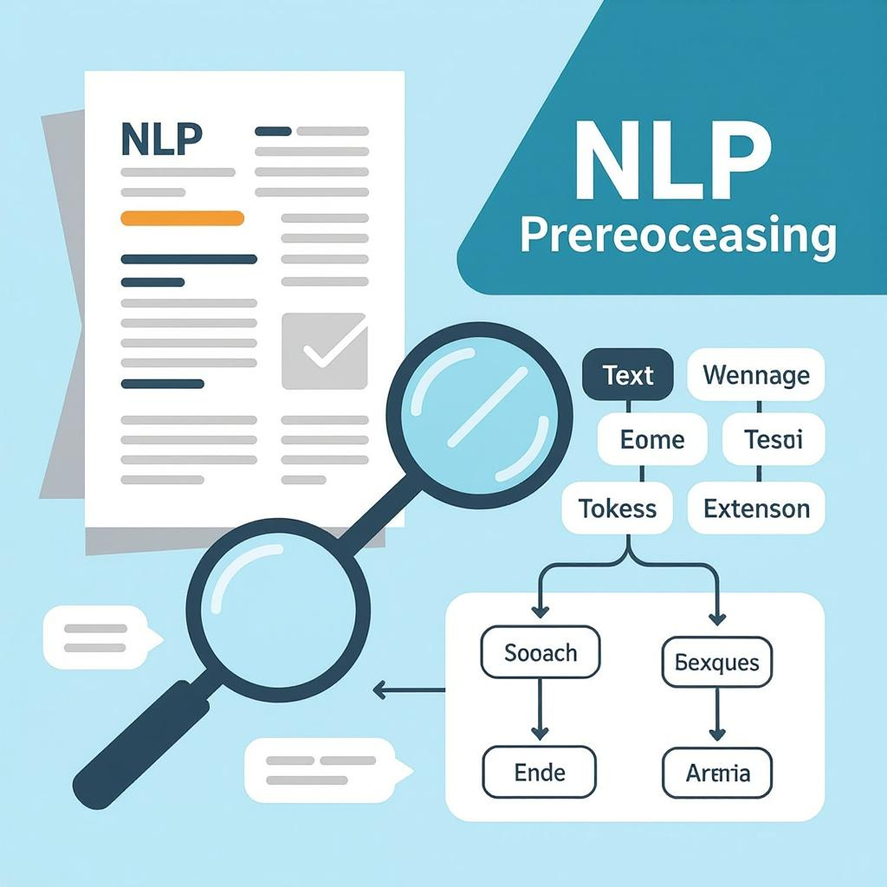
Introduction to Natural Language Processing (NLP)
Interdisciplinary Nature: NLP integrates computational linguistics and artificial intelligence for automated language comprehension and generation.
Enabling Human-Machine Interaction: NLP underpins AI systems facilitating communication, understanding, and response to natural human language inputs.
Key Applications: Applications include chatbots, machine translation, sentiment analysis, text summarization, and speech recognition technologies.
Generated on AIDOCMAKER.COM

Slide 5
The Role of NLP in AI
NLP as AI Subfield: NLP merges AI and machine learning to process and analyze diverse language data effectively.
Human-Machine Interaction: NLP enables seamless communication by interpreting natural language, facilitating user-friendly interfaces with machines.
Real-World Applications: Systems like Google Search, voice assistants, and automated customer support utilize NLP for enhanced user experience.

Slide 6
Key Challenges in NLP
Lexical and Syntactic Ambiguity: Words with multiple meanings and complex sentence structures complicate accurate language interpretation.
Multilingual and Dialect Variability: Diverse languages and dialects require adaptable models sensitive to linguistic and cultural nuances.
Data Sparsity and Noisy Text: Large vocabularies and informal text forms create sparse, inconsistent datasets challenging model robustness.

Slide 7
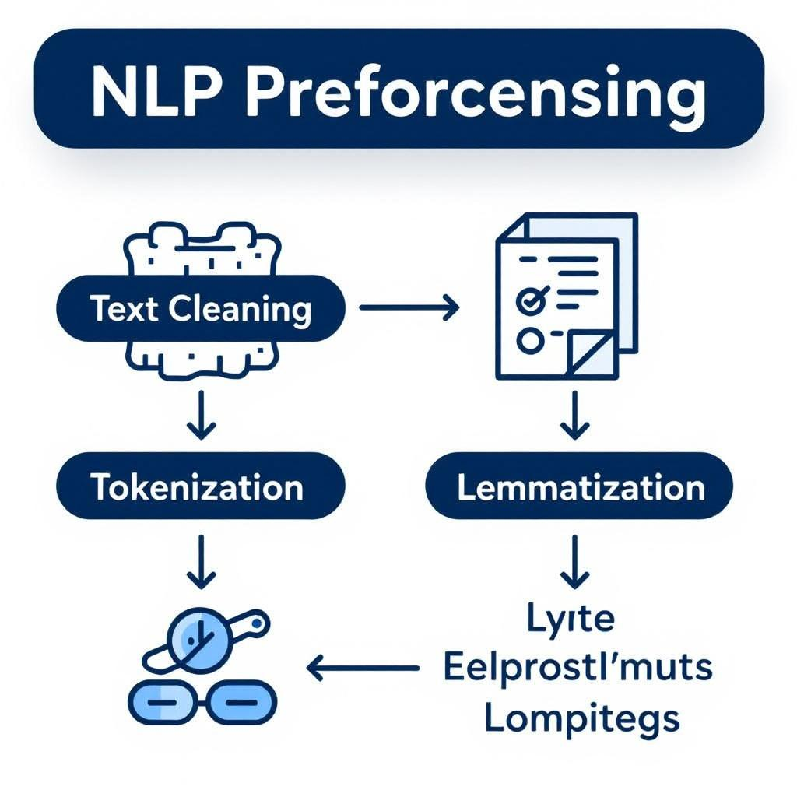
Overview of the NLP Pipeline
Text Collection: Raw textual data is gathered from varied sources like web pages, social media, and digital archives ensuring diversity.
Preprocessing Importance: Crucial for cleaning, normalizing, and structuring text to enhance downstream machine learning model accuracy and robustness.
Feature Extraction and Modeling: Features numerically represent text enabling model training for tasks such as classification, sentiment analysis, or translation.
Generated on AIDOCMAKER.COM

Slide 8
Tokenization
Word-Level Tokenization: Splitting text by whitespace and punctuation to isolate individual words, e.g., 'Hello world!' → ['Hello','world'].
Sentence-Level Tokenization: Dividing text into sentences based on punctuation and capitalization, e.g., 'Hello. World!' → ['Hello.','World!'].
Subword-Level Tokenization: Breaking words into smaller meaningful units to handle morphology, e.g., 'unhappiness' → ['un','happi','ness'].

Slide 9
Stop Word Removal
Definition and Role: Stop words are frequent, semantically light words removed to reduce irrelevant data noise effectively.
Processing Efficiency Benefits: Eliminating stop words decreases dataset size, accelerating downstream NLP tasks and improving model focus.
Common English Examples: Typical English stop words include "and," "the," "is," "in," "at," "which," and "on."

Slide 10
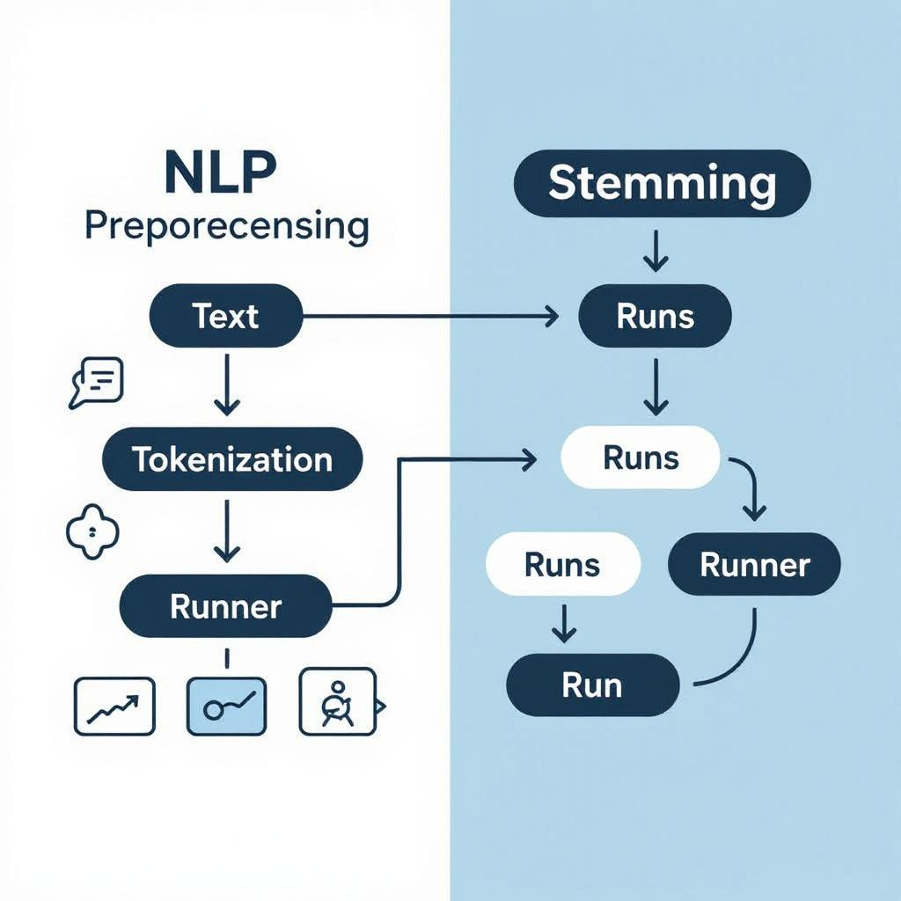
Stemming
Definition and Mechanism: Stemming heuristically reduces words to roots by chopping suffixes, simplifying word variants effectively.
Porter Stemmer Algorithm: Porter Stemmer is widely used, iteratively applying suffix stripping rules to derive root stems quickly.
Pros and Cons: Stemming offers simplicity and speed but may create non-words and ignores context, reducing linguistic accuracy.
Generated on AIDOCMAKER.COM

Slide 11
Lemmatization
Definition and Context: Lemmatization reduces words to their dictionary lemma form considering linguistic context, unlike simple root extraction.
Comparison with Stemming: Unlike stemming, lemmatization produces valid dictionary words ensuring semantic correctness and contextual relevance.
Tools and Trade-offs: WordNetLemmatizer is a popular tool; offers accuracy but requires more computation compared to stemming heuristics.

Slide 12
Lowercasing and Normalization
Standardization for Consistency: Lowercasing ensures uniform token representation, preventing mismatch due to case variations across text.
Punctuation Handling and Contraction Expansion: Removing punctuation and expanding contractions like "don't" to "do not" reduces ambiguity and diversifies vocabulary.
Vocabulary Size Reduction: Normalization clusters lexical variants, significantly reducing vocabulary dimensionality improving computational efficiency.

Slide 13
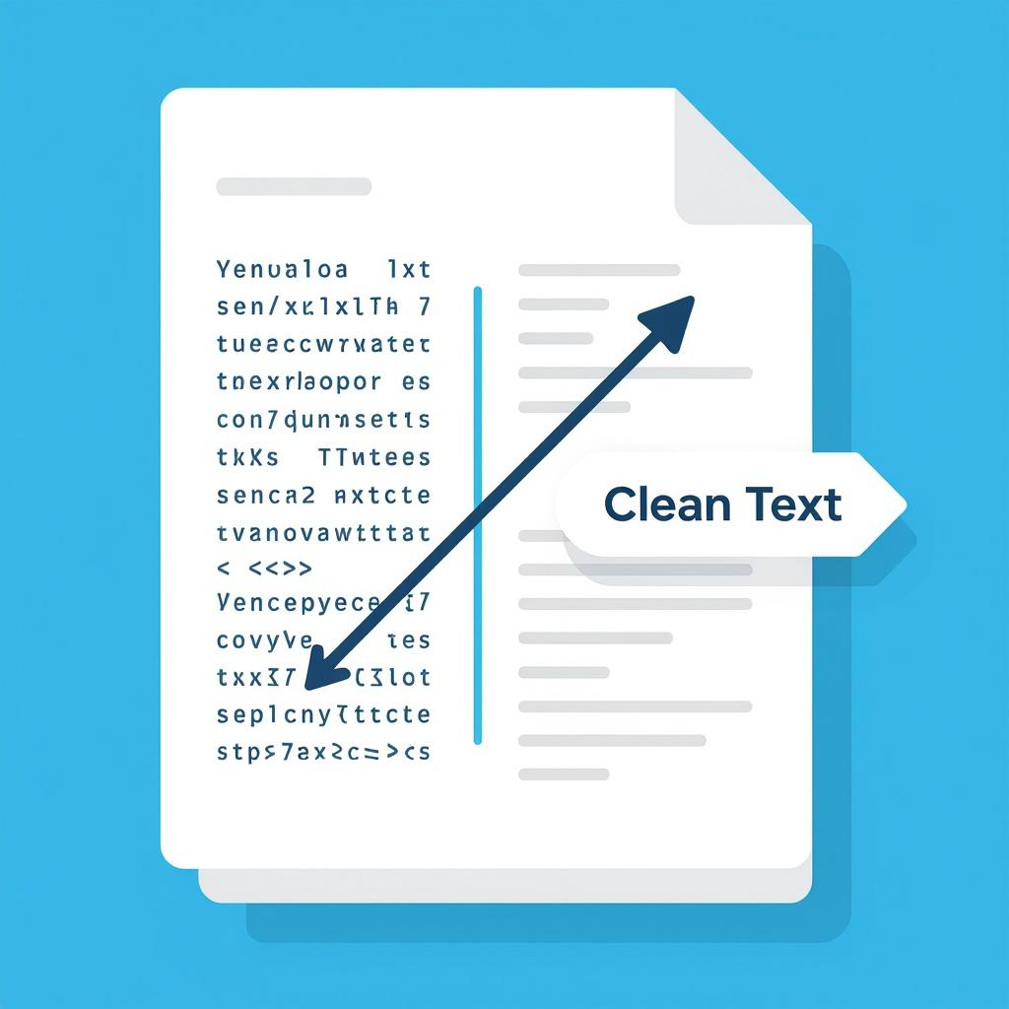
Removing Noise and Special Characters
Defining Noise in Text: Noise includes irrelevant symbols, numbers, HTML tags, and excessive whitespace disrupting text clarity.
Regex-based Pattern Removal: Regular expressions identify patterns to systematically remove unwanted characters from raw text data.
HTML Stripping and Whitespace Cleanup: HTML parsers extract text, while filters remove non-alphanumeric characters and extra spaces for normalization.
Generated on AIDOCMAKER.COM

Slide 14
POS Tagging and Named Entity Recognition (NER)
POS Tagging Fundamentals: POS tagging assigns grammatical categories like noun, verb, adjective, enabling syntactic parsing and disambiguation.
Named Entity Recognition Purpose: NER locates and classifies entities such as persons, organizations, or locations to structure semantic information.
Example Output Formats: Libraries like spaCy use JSON-like token arrays with attributes: text, POS tag, and entity label annotations.

Slide 15
Summary and Next Steps in NLP
Preprocessing Techniques Recap: Tokenization, stop word removal, stemming, lemmatization, normalization, noise removal, POS tagging, NER enhance data quality.
Role in Machine Learning: These preprocessing steps prepare textual data, improving feature quality critical for effective NLP model training and accuracy.
Future Learning Path: Explore feature extraction, embedding methods like word2vec, and practical training of machine learning models for NLP.

